Slide 1

Near-Linear Sample Complexity for $L_{p}$Polynomial Regression
Raphael A. Meyer
Cameron Musco
Christopher Musco
David P. Woodruff
Samson Zhou

Slide 2

Over 50% People CAN’T Solve This!!
What comes next?
?
?

Slide 3
Over 50% People CAN’T Solve This!!
What comes next?
?
?
1
4
9

Slide 4
Over 50% People CAN’T Solve This!!
What comes next?
?
?
1
4
9
16
25

Slide 5
Over 50% People CAN’T Solve This!!
What comes next?
?
1
4
9
22

Slide 6
Over 50% People CAN’T Solve This!!
What comes next?
1
4
9
22
49

Slide 7
Over 50% People CAN’T Solve This!!
What comes next?
1
4
9
22
49
$${q\left(x\right)=x}^{3}−5x^{2}+11x−6$$

Slide 8
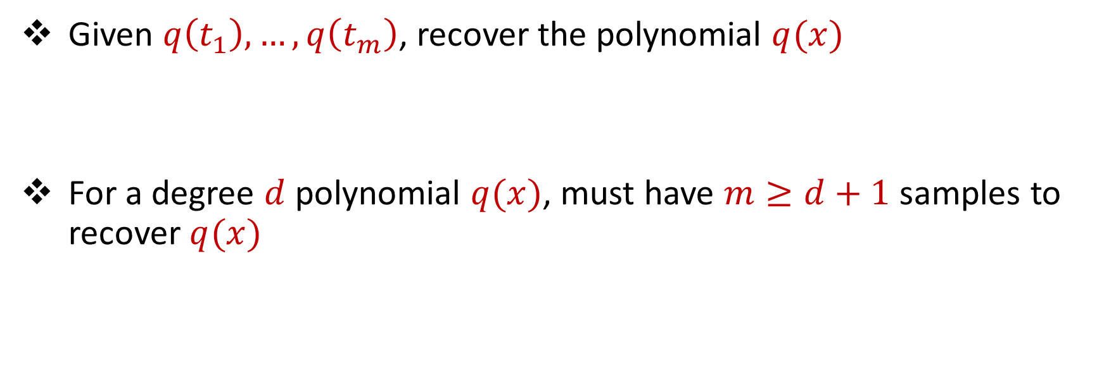
Polynomial Fitting
Given $q\left(t_{1}\right),…,q\left(t_{m}\right)$, recover the polynomial $q(x)$
For a degree $d$ polynomial $q(x)$, must have $m≥d+1$ samples to recover $q(x)$

Slide 9
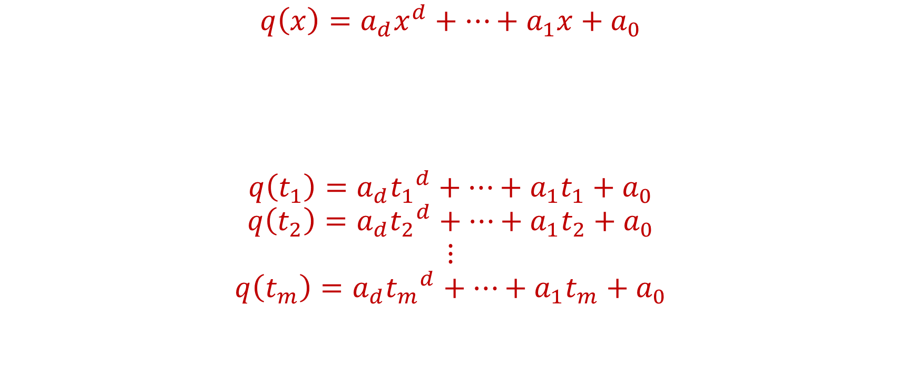
Polynomial Fitting
$$q\left(x\right)=a_{d}x^{d}+…+a_{1}x+a_{0}$$
$$q\left(t_{1}\right)=a_{d}{t_{1}}^{d}+…+a_{1}t_{1}+a_{0}$$
$$q\left(t_{2}\right)=a_{d}{t_{2}}^{d}+…+a_{1}t_{2}+a_{0}$$
$$⋮$$
$$q\left(t_{m}\right)=a_{d}{t_{m}}^{d}+…+a_{1}t_{m}+a_{0}$$

Slide 10
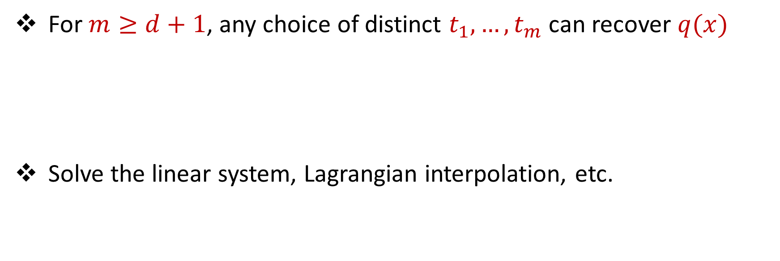
Polynomial Fitting
For $m≥d+1$, any choice of distinct $t_{1},…, t_{m}$ can recover $q(x)$
Solve the linear system, Lagrangian interpolation, etc.

Slide 11
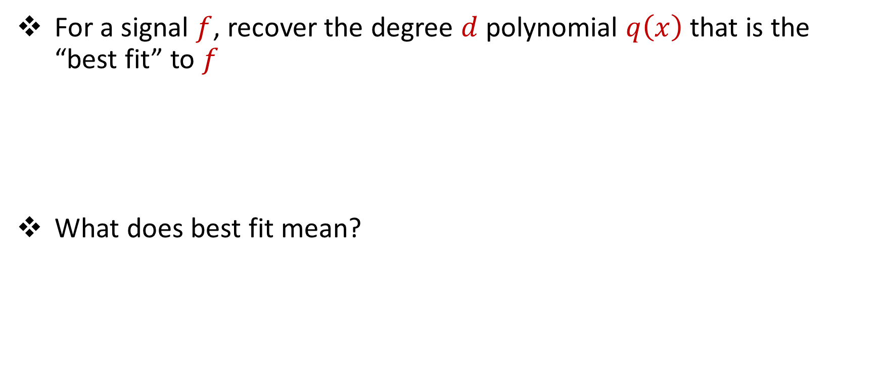
Polynomial Regression
For a signal $f$, recover the degree $d$ polynomial $q\left(x\right)$ that is the “best fit” to $f$
What does best fit mean?

Slide 12
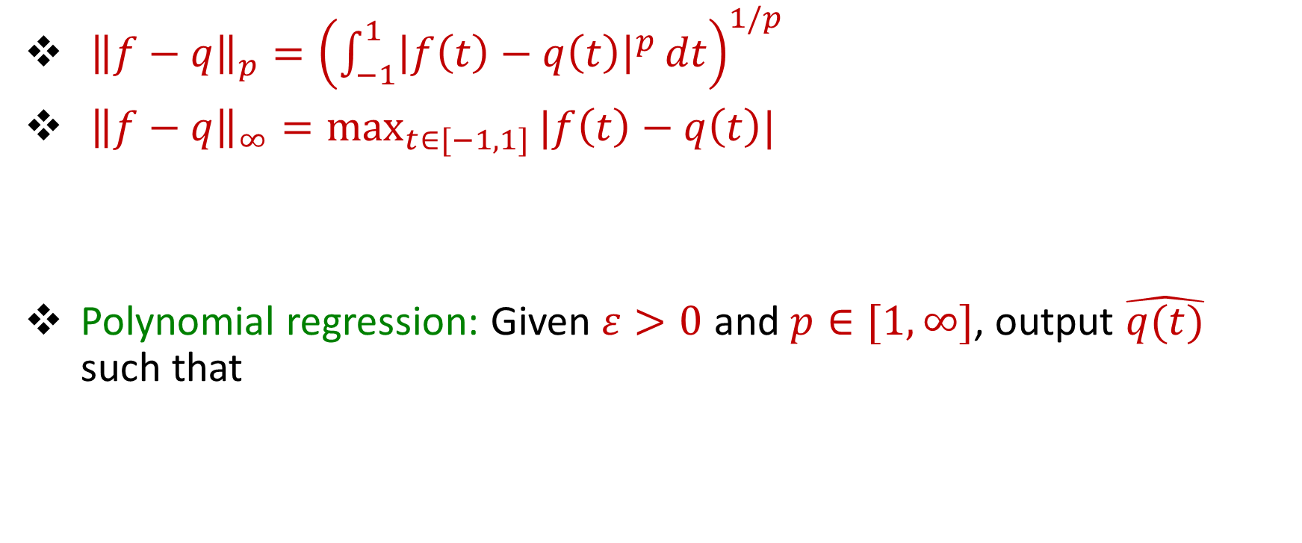
Polynomial Regression
${\left\|f−q\right\|}_{p}={\left(\int_{−1}^{1}{{\left|f\left(t\right)−q\left(t\right)\right|}^{p}}dt\right)}^{1/p}$
${\left\|f−q\right\|}_{∞}=\max_{t∈[−1,1]}{|f\left(t\right)−q\left(t\right)|}$
Polynomial regression: Given $ε>0$ and $p∈[1,∞]$, output $\hat{q(t)}$ such that
$${\left\|f−\hat{q}\right\|}_{p}≤(1+ε)\left(\min_{\deg\left(q\right)≤d}{{ \left\|f−q\right\|}_{p}}\right)$$

Slide 13
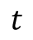
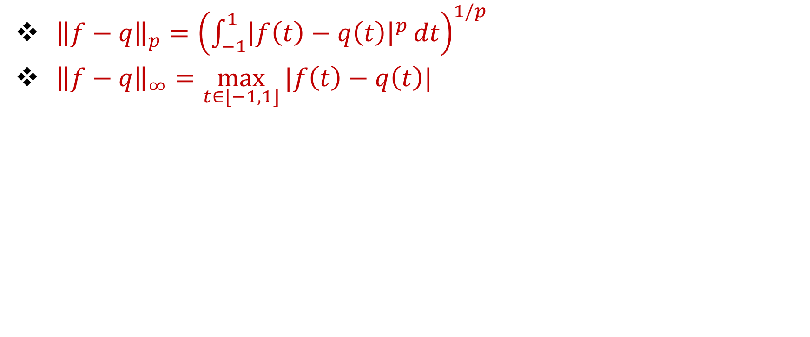
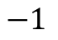

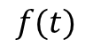
Polynomial Regression
${\left\|f−q\right\|}_{p}={\left(\int_{−1}^{1}{{\left|f\left(t\right)−q\left(t\right)\right|}^{p}}dt\right)}^{1/p}$
${\left\|f−q\right\|}_{∞}=\max_{t∈[−1,1]}{|f\left(t\right)−q\left(t\right)|}$
$$f(t)$$
$$t$$
$$−1$$
$$1$$

Slide 14
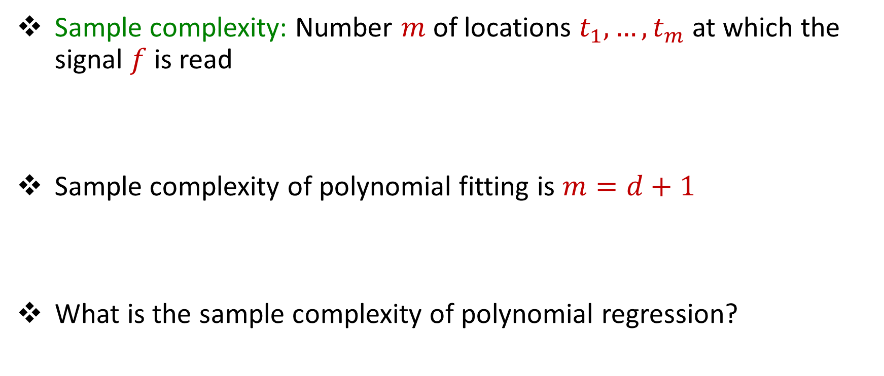
Sample Complexity
Sample complexity: Number $m$of locations $t_{1},…,t_{m}$ at which the signal $f$ is read
Sample complexity of polynomial fitting is $m=d+1$
What is the sample complexity of polynomial regression?

Slide 15
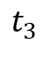
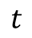
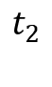
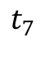
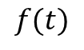
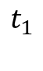
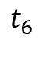
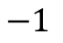
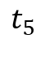

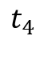
Deterministic Algorithms Do Not Work
$$f(t)$$
$$t_{1}$$
$$t_{2}$$
$$t_{3}$$
$$t_{4}$$
$$t_{5}$$
$$t_{6}$$
$$t_{7}$$
$$t$$
$$−1$$
$$1$$

Slide 16
Deterministic Algorithms Do Not Work
$$f(t)$$
$$t_{1}$$
$$t_{2}$$
$$t_{3}$$
$$t_{4}$$
$$t_{5}$$
$$t_{6}$$
$$t_{7}$$
$$t$$
$$−1$$
$$1$$

Slide 17
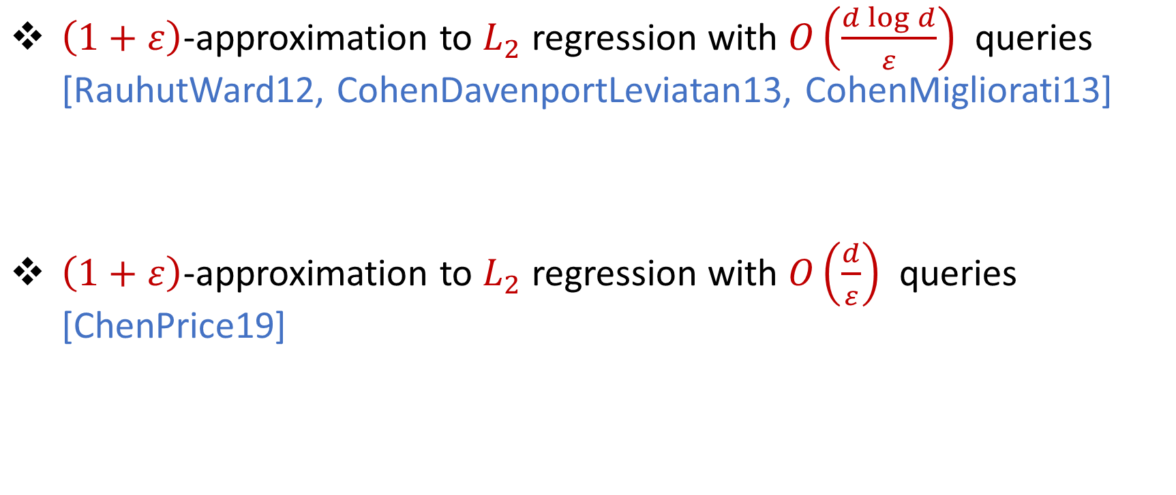

Previous Work for $L_{2}$ Regression
$\left(1+ε\right)$-approximation to $L_{2}$ regression with $O\left(\frac{d\log{d}}{ε}\right)$ queries [RauhutWard12, CohenDavenportLeviatan13, CohenMigliorati13]
$\left(1+ε\right)$-approximation to $L_{2}$ regression with $O\left(\frac{d}{ε}\right)$ queries [ChenPrice19]

Slide 18
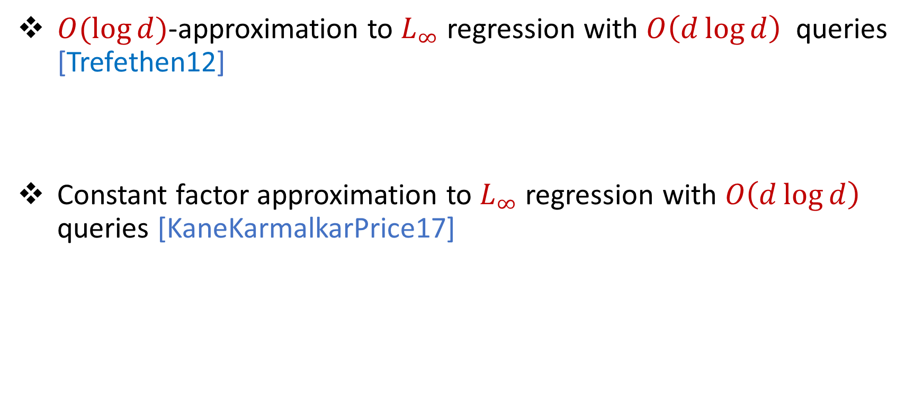

Previous Work for $L_{∞}$ Regression
$O(\log{d)}$-approximation to $L_{∞}$ regression with $O\left(d\log{d}\right)$ queries [Trefethen12]
Constant factor approximation to $L_{∞}$ regression with $O\left(d\log{d}\right)$ queries [KaneKarmalkarPrice17]

Slide 20
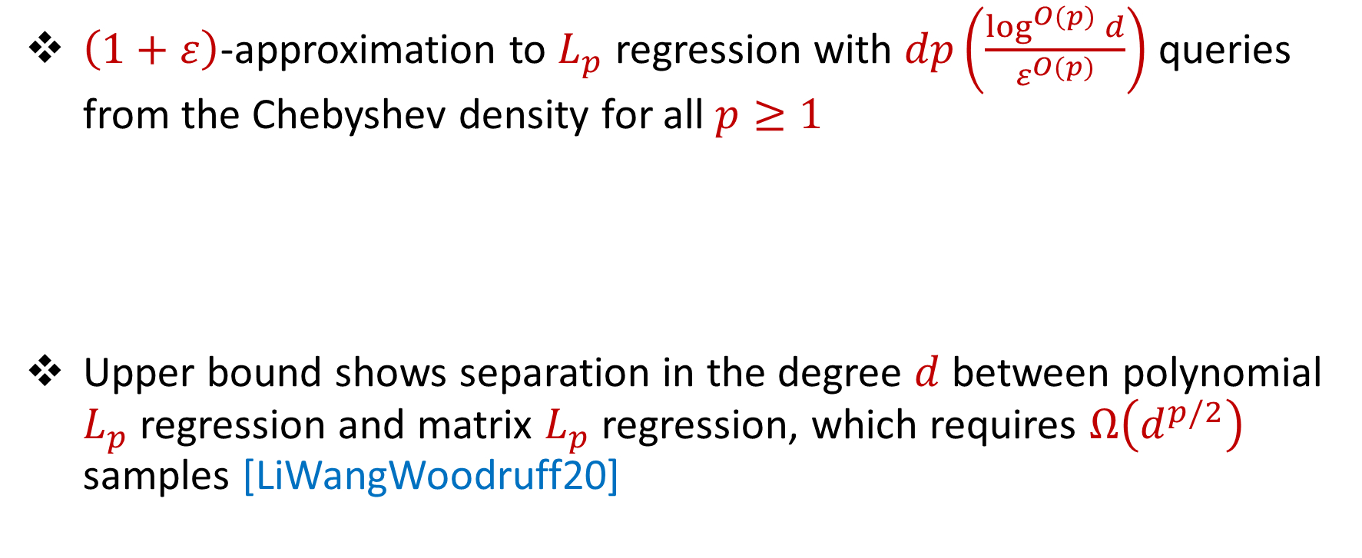
Our Results (I)
$\left(1+ε\right)$-approximation to $L_{p}$ regression with $dp\left(\frac{\log^{O(p)}{d}}{ε^{O(p)}}\right)$ queries from the Chebyshev density for all $p≥1$
Upper bound shows separation in the degree $d$ between polynomial $L_{p}$ regression and matrix $L_{p}$ regression, which requires $Ω\left(d^{p/2}\right)$ samples [LiWangWoodruff20]

Slide 21
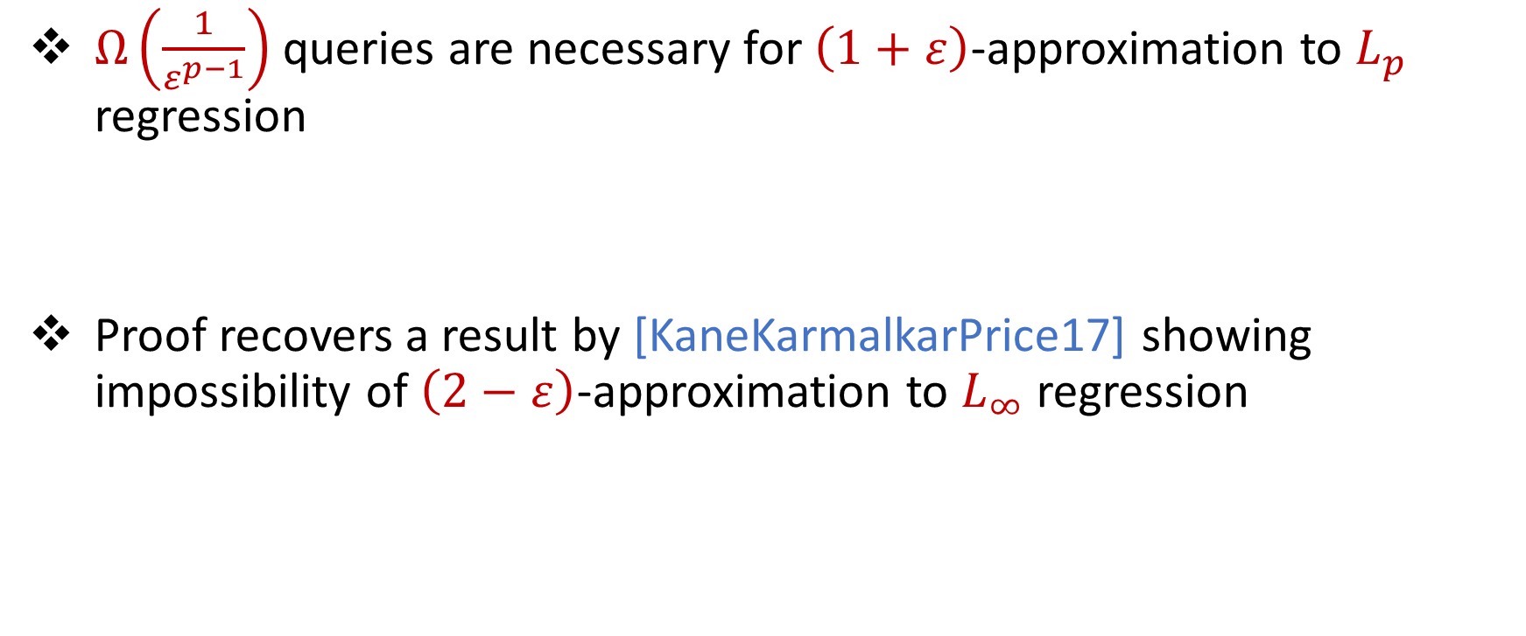
Our Results (II)
$Ω\left(\frac{1}{ε^{p−1}}\right)$ queries are necessary for $\left(1+ε\right)$-approximation to $L_{p}$ regression
Proof recovers a result by [KaneKarmalkarPrice17] showing impossibility of $\left(2−ε\right)$-approximation to $L_{∞}$ regression

Slide 23
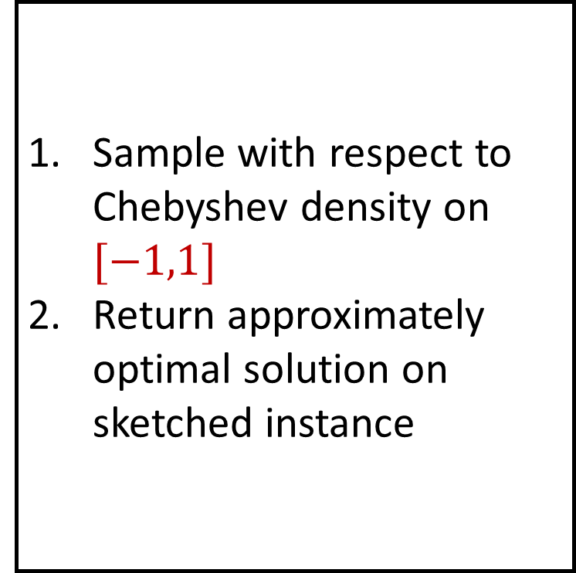
Algorithm
Sample with respect to Chebyshev density on $[−1,1]$
Return approximately optimal solution on sketched instance

Slide 24
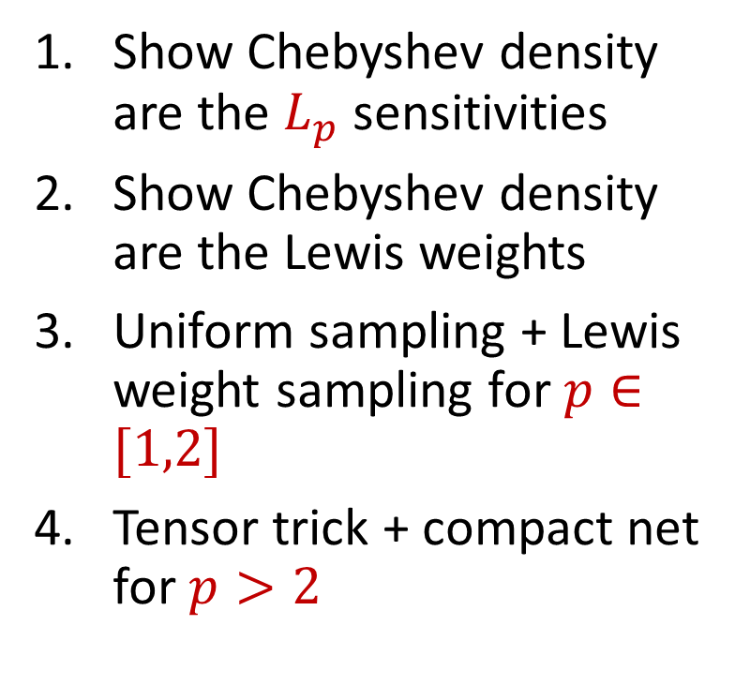
Format
Questions?
Part 1: Background
Part 2: Subspace Embeddings
Part 3: Lewis Weights
Part 4: Algorithm
Show Chebyshev density are the $L_{p}$ sensitivities
Show Chebyshev density are the Lewis weights
Uniform sampling + Lewis weight sampling for $p∈[1,2]$
Tensor trick + compact net for $p>2$

Slide 25
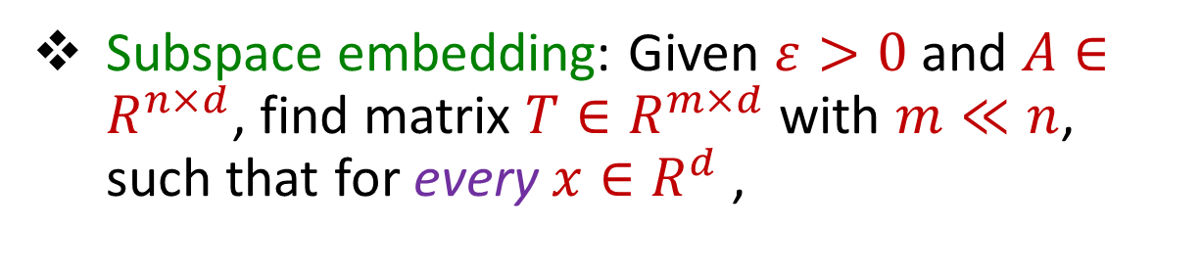
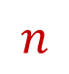



Subspace Embedding
Subspace embedding: Given $ε>0$ and $A∈R^{n×d}$, find matrix $T∈R^{m×d}$ with $m≪n$, such that for every $x∈R^{d}$,
$$x$$
$$n$$
$$A$$
$$\left(1−ε\right){\left\|Ax\right\|}_{p}≤{\left\|Tx\right\|}_{p}≤\left(1+ε\right){\left\|Ax\right\|}_{p}$$
$$d$$

Slide 26

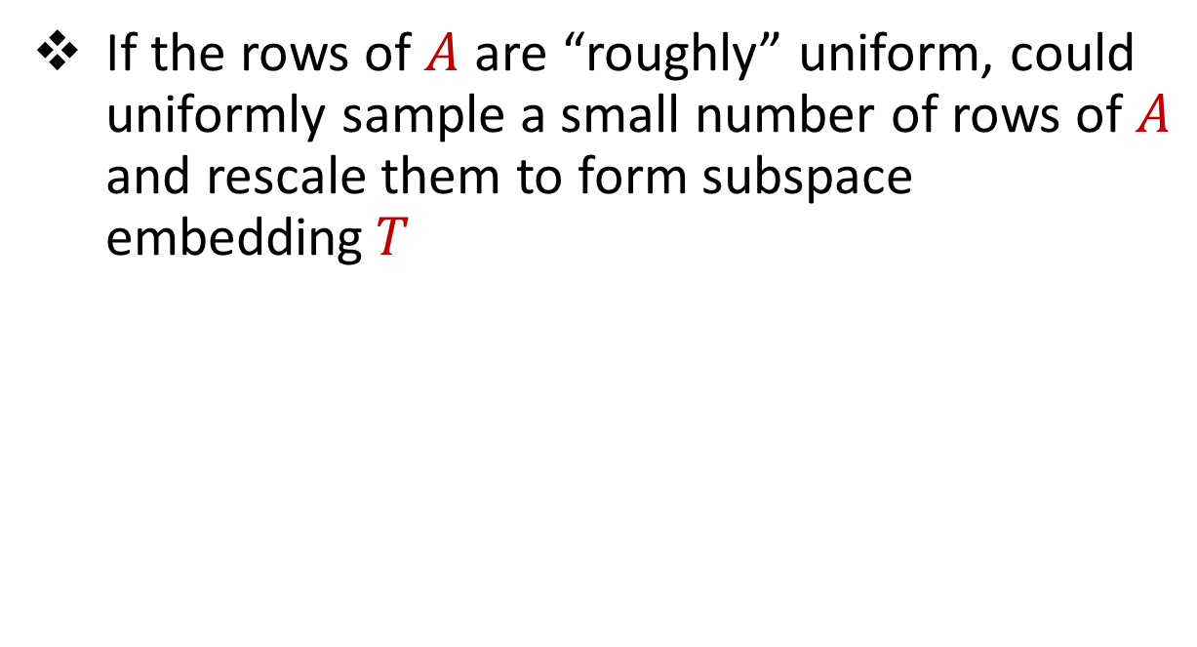
Subspace Embedding
1 0 0 0 0 0
1 0 0 0 0 0
1 0 0 0 0 0
1 0 0 0 0 0
1 0 0 0 0 0
1 0 0 0 0 0
1 0 0 0 0 0
If the rows of $A$ are “roughly” uniform, could uniformly sample a small number of rows of $A$ and rescale them to form subspace embedding$T$
$$n$$
$$A$$
$$d$$

Slide 27
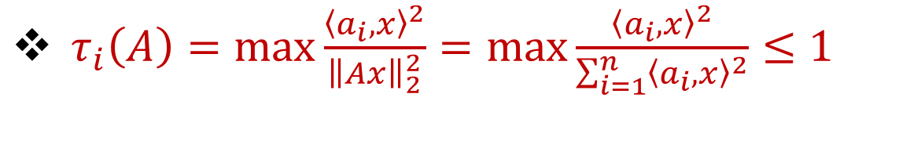
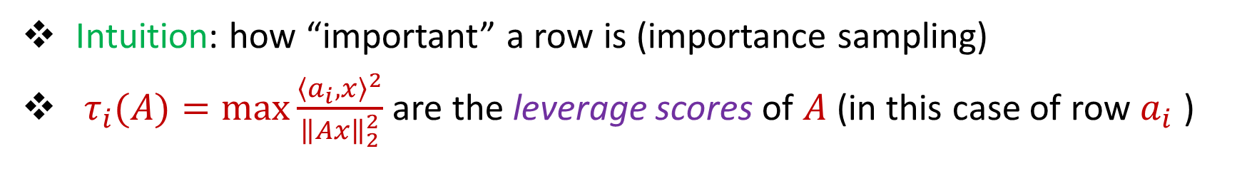
Leverage Scores
Intuition: how “important” a row is (importance sampling)
$τ_{i}(A)=\max{\frac{{\left\langle a_{i},x\right\rangle }^{2}}{{\left\|Ax\right\|}_{2}^{2}}}$ are the leverage scores of $A$ (in this case of row $a_{i}$ )
$τ_{i}\left(A\right)=\max{\frac{{\left\langle a_{i},x\right\rangle }^{2}}{{\left\|Ax\right\|}_{2}^{2}}}=\max{\frac{{\left\langle a_{i},x\right\rangle }^{2}}{\sum_{i=1}^{n}{{\left\langle a_{i},x\right\rangle }^{2}}}≤1}$
1 0
1 1

Slide 28
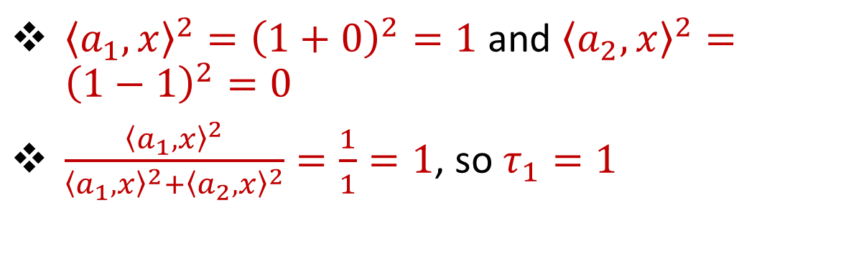
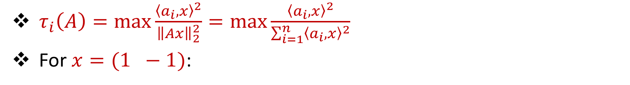
Leverage Scores
$τ_{i}\left(A\right)=\max{\frac{{\left\langle a_{i},x\right\rangle }^{2}}{{\left\|Ax\right\|}_{2}^{2}}}=\max{\frac{{\left\langle a_{i},x\right\rangle }^{2}}{\sum_{i=1}^{n}{{\left\langle a_{i},x\right\rangle }^{2}}}}$
For $x=(1 −1)$:
1
-1
${\left\langle a_{1},x\right\rangle }^{2}={\left(1+0\right)}^{2}=1$ and ${\left\langle a_{2},x\right\rangle }^{2}={\left(1−1\right)}^{2}=0$
$\frac{{\left\langle a_{1},x\right\rangle }^{2}}{{\left\langle a_{1},x\right\rangle }^{2}+{\left\langle a_{2},x\right\rangle }^{2}}=\frac{1}{1}=1$, so $τ_{1}=1$
1 0
1 1

Slide 29
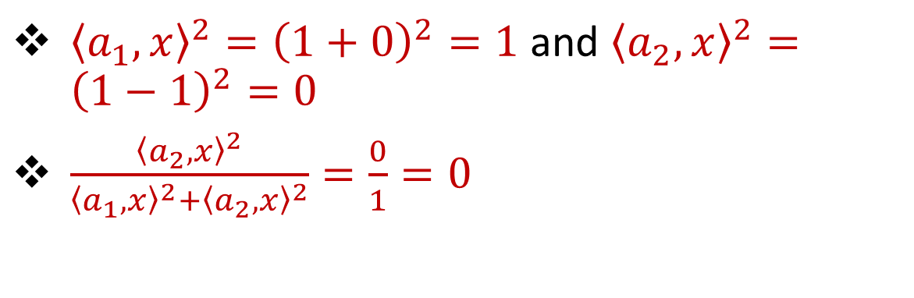
Leverage Scores
$τ_{i}\left(A\right)=\max{\frac{{\left\langle a_{i},x\right\rangle }^{2}}{{\left\|Ax\right\|}_{2}^{2}}}=\max{\frac{{\left\langle a_{i},x\right\rangle }^{2}}{\sum_{i=1}^{n}{{\left\langle a_{i},x\right\rangle }^{2}}}}$
For $x=(1 −1)$:
1
-1
${\left\langle a_{1},x\right\rangle }^{2}={\left(1+0\right)}^{2}=1$ and ${\left\langle a_{2},x\right\rangle }^{2}={\left(1−1\right)}^{2}=0$
$\frac{{\left\langle a_{2},x\right\rangle }^{2}}{{\left\langle a_{1},x\right\rangle }^{2}+{\left\langle a_{2},x\right\rangle }^{2}}=\frac{0}{1}=0$
1 0
1 1

Slide 30
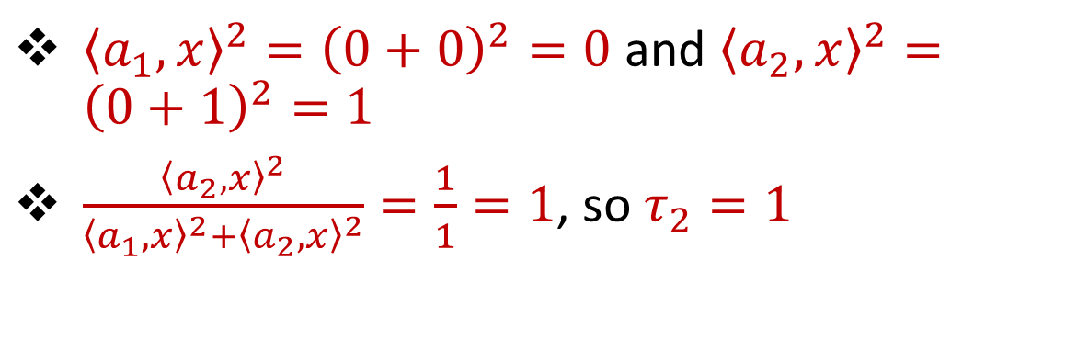
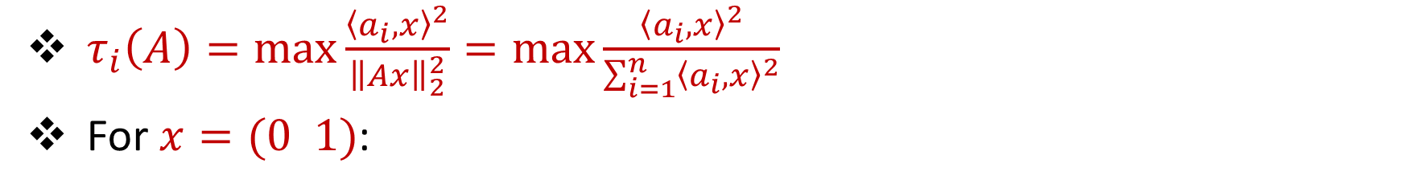
Leverage Scores
$τ_{i}\left(A\right)=\max{\frac{{\left\langle a_{i},x\right\rangle }^{2}}{{\left\|Ax\right\|}_{2}^{2}}}=\max{\frac{{\left\langle a_{i},x\right\rangle }^{2}}{\sum_{i=1}^{n}{{\left\langle a_{i},x\right\rangle }^{2}}}}$
For $x=(0 1)$:
0
1
${\left\langle a_{1},x\right\rangle }^{2}={\left(0+0\right)}^{2}=0$ and ${\left\langle a_{2},x\right\rangle }^{2}={\left(0+1\right)}^{2}=1$
$\frac{{\left\langle a_{2},x\right\rangle }^{2}}{{\left\langle a_{1},x\right\rangle }^{2}+{\left\langle a_{2},x\right\rangle }^{2}}=\frac{1}{1}=1$, so $τ_{2}=1$
1 0
1 1

Slide 31
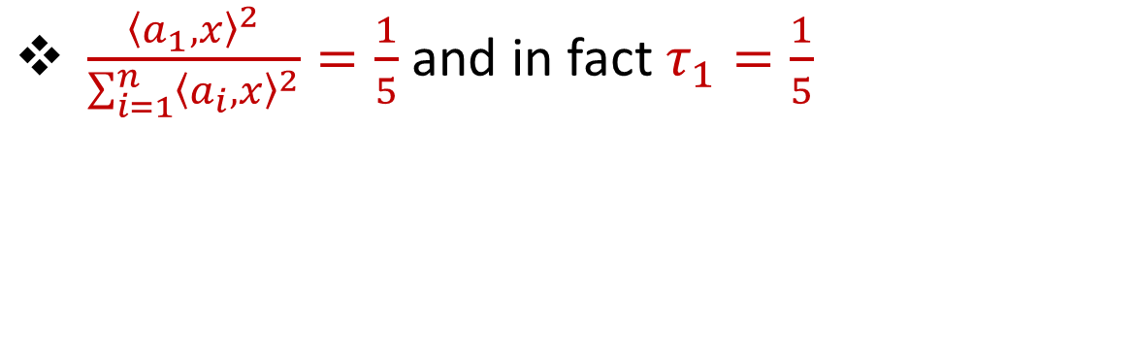

Leverage Scores
$τ_{i}\left(A\right)=\max{\frac{{\left\langle a_{i},x\right\rangle }^{2}}{{\left\|Ax\right\|}_{2}^{2}}}=\max{\frac{{\left\langle a_{i},x\right\rangle }^{2}}{\sum_{i=1}^{n}{{\left\langle a_{i},x\right\rangle }^{2}}}}$
For $x=(1 0)$:
1 0
1 0
1 0
1 0
1 0
0 1
1
0
$\frac{{\left\langle a_{1},x\right\rangle }^{2}}{\sum_{i=1}^{n}{{\left\langle a_{i},x\right\rangle }^{2}}}=\frac{1}{5}$ and in fact $τ_{1}=\frac{1}{5}$

Slide 32

Leverage Scores
Intuition: how “important” a row is (importance sampling)
$τ_{i}(A)=\max{\frac{{\left\langle a_{i},x\right\rangle }^{2}}{{\left\|Ax\right\|}_{2}^{2}}}$ are the leverage scores of $A$ (in this case of row $a_{i}$ )
Take $x=(1 −1)$ to see that $τ_{1}=1$
Take $x=(0 1)$ to see that $τ_{2}=1$
1 0
1 1

Slide 33


Leverage Scores
Intuition: how “important” a row is (importance sampling)
$τ_{i}(A)=\max{\frac{{\left\langle a_{i},x\right\rangle }^{2}}{{\left\|Ax\right\|}_{2}^{2}}}$ are the leverage scores of $A$ (in this case of row $a_{i}$ )
Take $x=(1 −1)$ to see that $τ_{1}=1$
Take $x=(0 1)$ to see that $τ_{2}=1$
1 0
1 1
$τ_{i}(A)=a_{i}{\left(A^{⊤}A\right)}^{−1}a_{i}^{⊤}$, ${∑τ}_{i}=d$
$$A$$
$$a_{i}$$

Slide 34
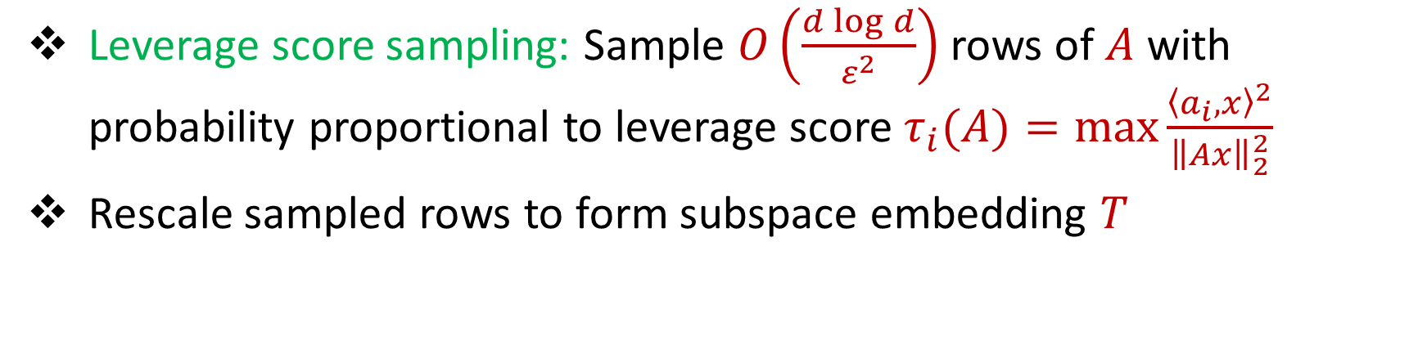
Leverage Scores
Leverage score sampling: Sample $O\left(\frac{d\log{d}}{ε^{2}}\right)$ rows of $A$ with probability proportional to leverage score$τ_{i}(A)=\max{\frac{{\left\langle a_{i},x\right\rangle }^{2}}{{\left\|Ax\right\|}_{2}^{2}}}$
Rescale sampled rows to form subspace embedding $T$
$$\left(1−ε\right){\left\|Ax\right\|}_{2}≤{\left\|Tx\right\|}_{2}≤\left(1+ε\right){\left\|Ax\right\|}_{2}$$

Slide 35



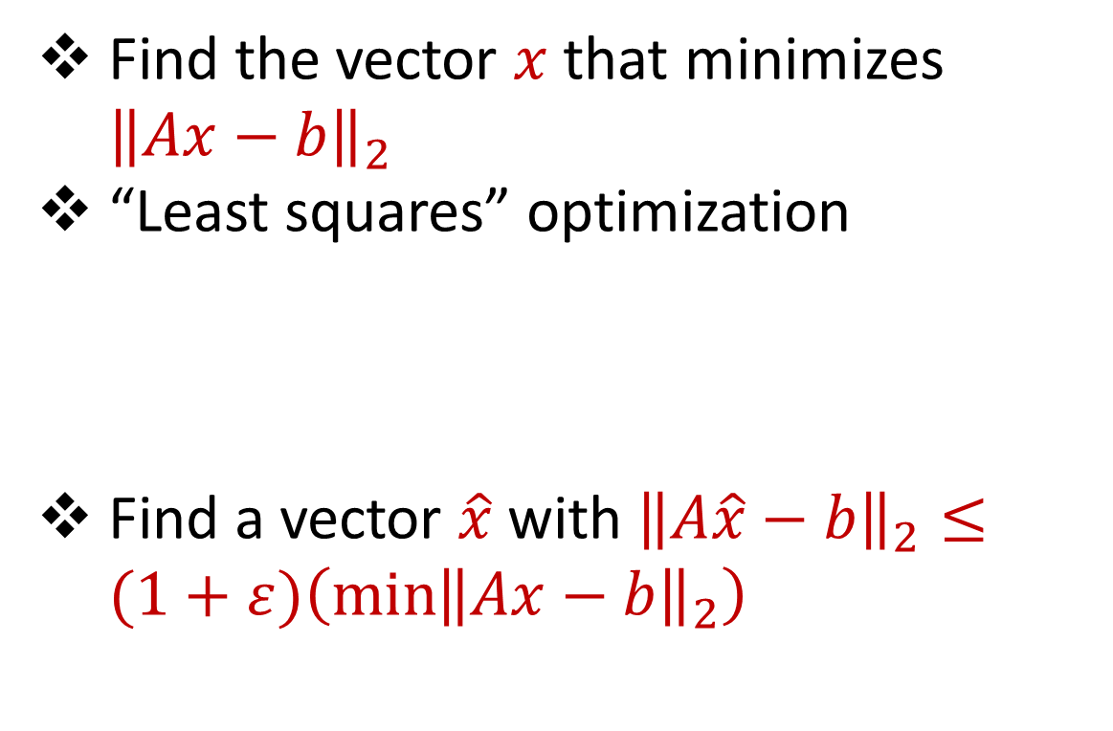






Linear Regression
Find the vector $x$ that minimizes ${\left\|Ax−b\right\|}_{2}$
“Least squares” optimization
Find a vector $\hat{x}$ with ${\left\|A\hat{x}−b\right\|}_{2}≤(1+ε)\left(\min{{\left\|Ax−b\right\|}_{2}}\right)$
$$d$$
$$x$$
$$≈$$
$$n$$
$$A$$
$$n$$
$$b$$
$$1$$
$$d$$
$$1$$

Slide 36

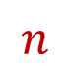

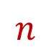



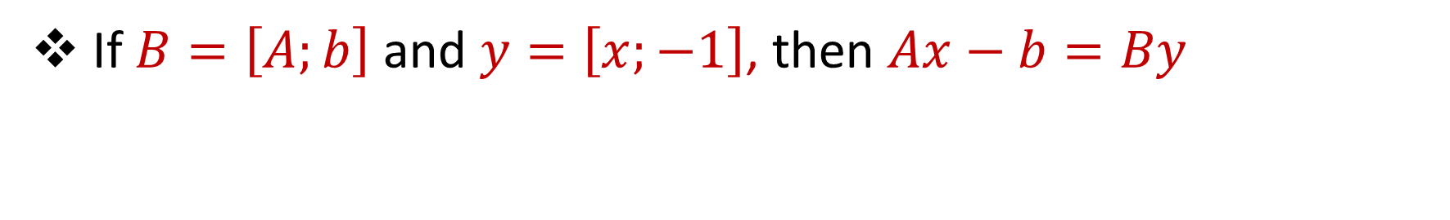




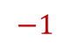



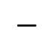

Linear Regression
If $B=\left[A;b\right]$ and $y=\left[x;−1\right]$, then $Ax−b=By$
$$d$$
$$x$$
$$−$$
$$x$$
$$n$$
$$A$$
$$n$$
$$b$$
$$n$$
$$A$$
$$b$$
$$1$$
$$−1$$
$$d$$
$$1$$
$$d$$
$$1$$

Slide 37
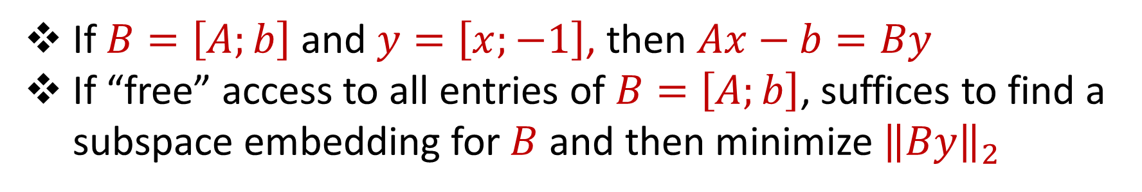
Linear Regression
If $B=\left[A;b\right]$ and $y=\left[x;−1\right]$, then $Ax−b=By$
If “free” access to all entries of $B=\left[A;b\right]$, suffices to find a subspace embedding for $B$ and then minimize ${\left\|By\right\|}_{2}$

Slide 38









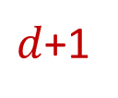
Linear Regression to Polynomial Regression
$$d$$
$$x$$
$$≈$$
$d$+1
$$x$$
$$≈$$
$$n$$
$$A$$
$$n$$
$$b$$
$$∞$$
$$P$$
$$∞$$
$$f$$
$$1$$
$$1$$
$$d$$
$$1$$
$$d$$
$$1$$

Slide 39
Linear Regression to Polynomial Regression
$$d$$
$$x$$
$$≈$$
$$n$$
$$A$$
$$n$$
$$b$$
$$1$$
$$d$$
$$1$$

Slide 40
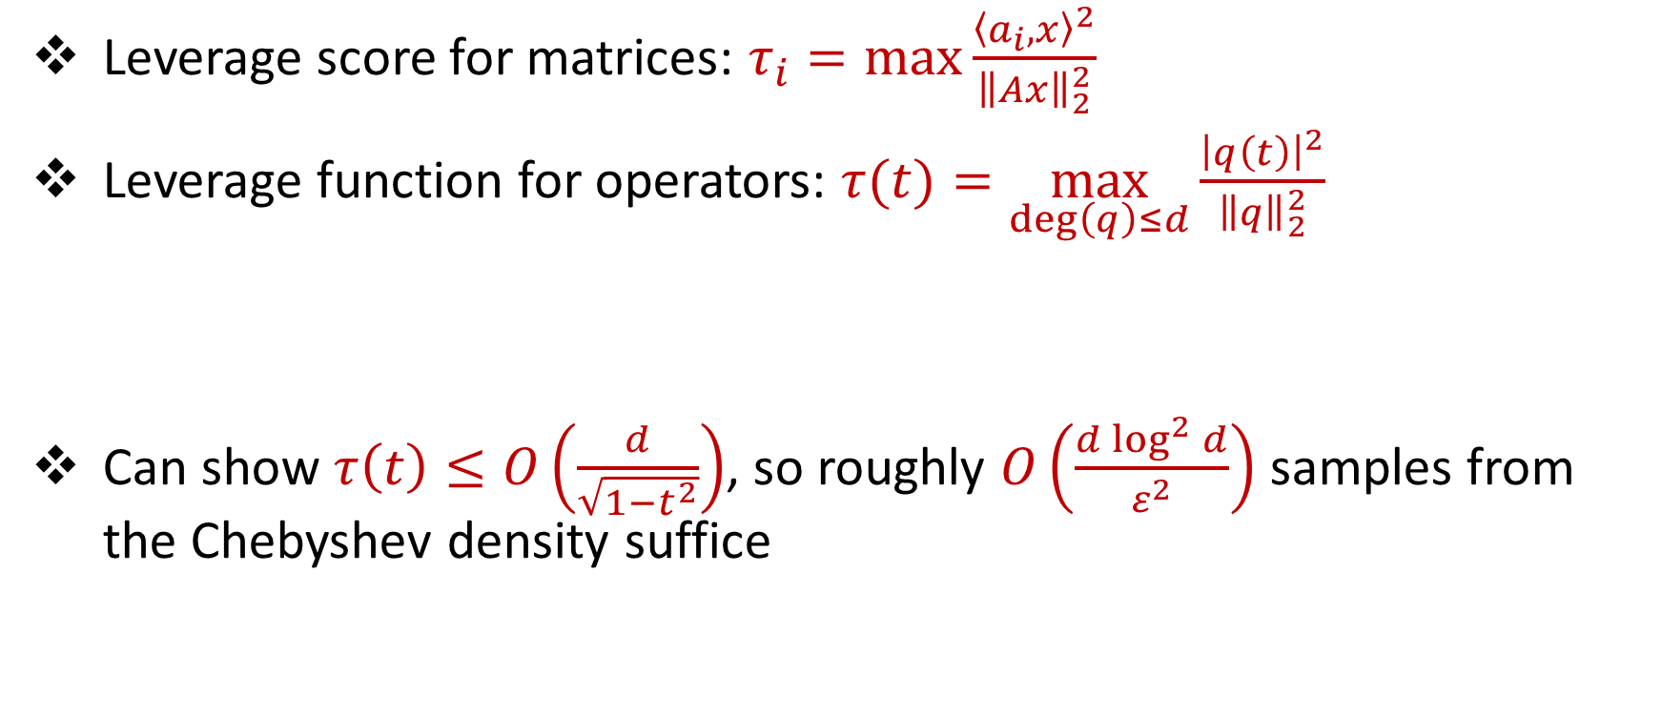
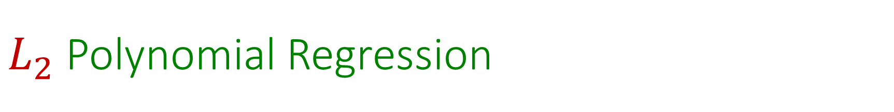
$L_{2}$ Polynomial Regression
Leverage score for matrices: $τ_{i}=\max{\frac{{\left\langle a_{i},x\right\rangle }^{2}}{{\left\|Ax\right\|}_{2}^{2}}}$
Leverage function for operators: $τ(t)=\max_{\deg\left(q\right)≤d}{\frac{{\left|q\left(t\right)\right|}^{2}}{{\left\|q\right\|}_{2}^{2}}}$
Can show $τ\left(t\right)≤O\left(\frac{d}{\sqrt{1−t^{2}}}\right)$, so roughly $O\left(\frac{d\log^{2}{d}}{ε^{2}}\right)$ samples from the Chebyshev density suffice

Slide 41
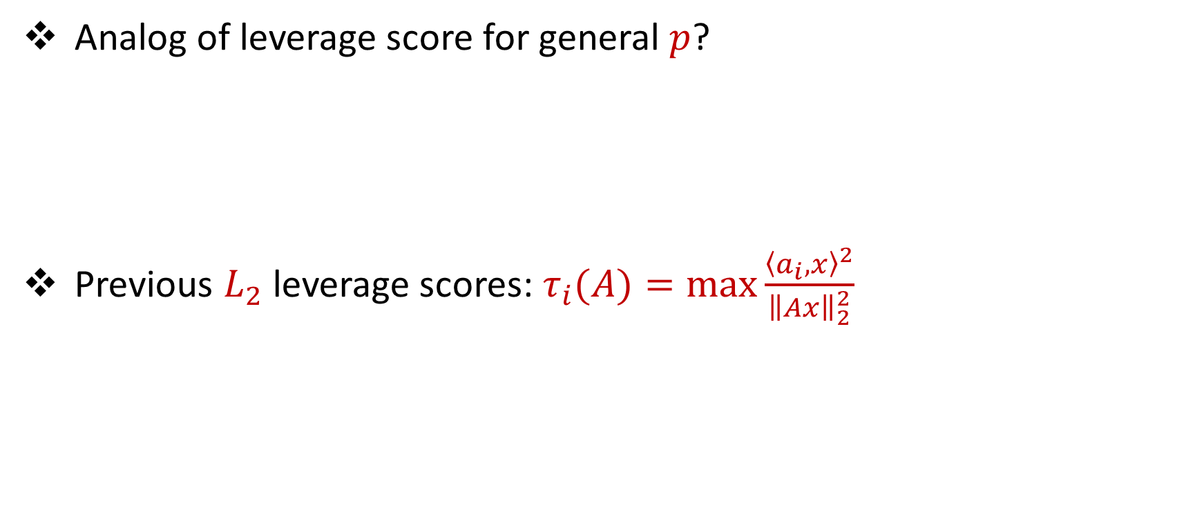

Toward General $p$
Analog of leverage score for general $p$?
Previous $L_{2}$ leverage scores: $τ_{i}(A)=\max{\frac{{\left\langle a_{i},x\right\rangle }^{2}}{{\left\|Ax\right\|}_{2}^{2}}}$

Slide 42
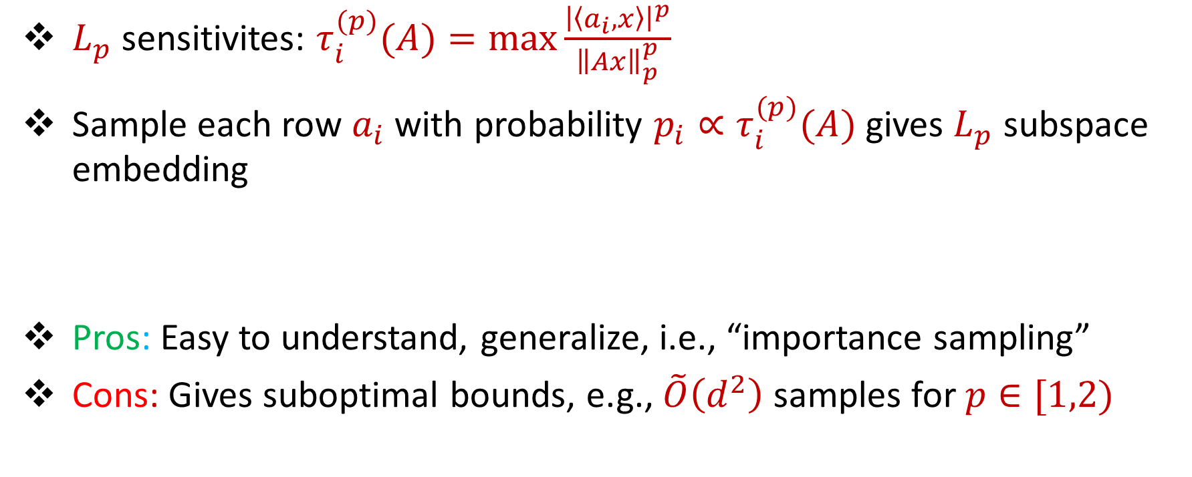

$L_{p}$ Sensitivities
$L_{p}$ sensitivites: $τ_{i}^{(p)}(A)=\max{\frac{{\left|\left\langle a_{i},x\right\rangle \right|}^{p}}{{\left\|Ax\right\|}_{p}^{p}}}$
Sample each row $a_{i}$ with probability $p_{i}∝τ_{i}^{(p)}(A)$ gives $L_{p}$ subspace embedding
Pros: Easy to understand, generalize, i.e., “importance sampling”
Cons: Gives suboptimal bounds, e.g., $\tilde{O}\left(d^{2}\right)$ samples for $p∈[1,2)$

Slide 43

$L_{p}$ Sensitivities
$L_{p}$ sensitivities for matrices: $τ_{i}^{(p)}(A)=\max{\frac{{\left|\left\langle a_{i},x\right\rangle \right|}^{p}}{{\left\|Ax\right\|}_{p}^{p}}}$
$L_{p}$ sensitivities for operators: $τ^{(p)}(t)=\max_{\deg\left(q\right)≤d}{\frac{{\left|q\left(t\right)\right|}^{p}}{{\left\|q\right\|}_{p}^{p}}}$
Want to bound $τ^{(p)}(t)$

Slide 44







Upper Bound for $L_{p}$ Sensitivities
Structural result: $τ^{\left(p\right)}\left(t\right)=\max_{\deg\left(q\right)≤d}{\frac{{\left|q\left(t\right)\right|}^{p}}{{\left\|q\right\|}_{p}^{p}}}≤O\left(\min\left(\frac{dp\log{d}}{\sqrt{1−t^{2}}},d^{2}p\right)\right)$
Normalize $q\left(t\right)=1$, how small can ${\left\|q\right\|}_{p}^{p}$ be?
$$1$$
$$q(t)$$
$$−1$$
$$t$$
$$1$$

Slide 45

Upper Bound for $L_{p}$ Sensitivities
Bernstein’s inequality: If $q$ is a polynomial with degree $d$ and $|q\left(t\right)|≤1$ for $t∈[−1,1]$, then $|q′\left(t\right)|≤\frac{d}{\sqrt{1−t^{2}}}$ for all $t∈[−1,1]$
Markov brothers’ inequality: If $q$ is a polynomial with degree $d$ and $|q\left(t\right)|≤1$ for $t∈[−1,1]$, then $|q′\left(t\right)|≤d^{2}$ for all $t∈[−1,1]$

Slide 46

$L_{p}$ Sensitivities
If $|q|$ achieves maximum at $t$, then ${\left\|q\right\|}_{p}^{p}≥Ω\left(\max\left(\frac{\sqrt{1−t^{2}}}{dp},\frac{1}{d^{2}p}\right)\right)$
Otherwise, show there exists a degree $O(d\log{d)}$ polynomial $r$ that achieves maximum “near” $t$ and $\left|{\left\|r\right\|}_{p}^{p}−{\left\|q\right\|}_{p}^{p}\right|≤\frac{1}{d^{3}}$

Slide 47

$L_{p}$ Sensitivities
Structural result: $τ^{\left(p\right)}\left(t\right)=\max_{\deg\left(q\right)≤d}{\frac{{\left|q\left(t\right)\right|}^{p}}{{\left\|q\right\|}_{p}^{p}}}≤O\left(\min\left(\frac{dp\log{d}}{\sqrt{1−t^{2}}},d^{2}p\right)\right)$
Constant factor approximation to $L_{p}$ regression with $poly(d,p)$ queries from the Chebyshev density for all $p≥1$, showing separation between polynomial $L_{p}$ regression and matrix $L_{p}$ regression, which requires $Ω\left(d^{p/2}\right)$ samples [LiWangWoodruff20]

Slide 48
Format
Questions?
Part 1: Background
Part 2: Subspace Embeddings
Part 3: Lewis Weights
Part 4: Algorithm
Show Chebyshev density are the $L_{p}$ sensitivities
Show Chebyshev density are the Lewis weights
Uniform sampling + Lewis weight sampling for $p∈[1,2]$
Tensor trick + compact net for $p>2$

Slide 49
$L_{p}$ Sensitivities
$L_{p}$ sensitivites: $τ_{i}^{(p)}(A)=\max{\frac{{\left|\left\langle a_{i},x\right\rangle \right|}^{p}}{{\left\|Ax\right\|}_{p}^{p}}}$
Sample each row $a_{i}$ with probability $p_{i}∝τ_{i}^{(p)}(A)$ gives $L_{p}$ subspace embedding
Pros: Easy to understand, generalize, i.e., “importance sampling”
Cons: Gives suboptimal bounds, e.g., $\tilde{O}\left(d^{2}\right)$ samples for $p∈[1,2)$

Slide 50


$L_{p}$ Lewis Weights
$L_{p}$ Lewis weights [CohenPeng15]: $w_{i}=τ_{i}\left(W^{\frac{1}{2}−\frac{1}{p}}A\right)$
Sample each row $a_{i}$ with probability $p_{i}∝w_{i}$ gives $L_{p}$ subspace embedding
Pros: Gives near-optimal bounds, e.g., $\tilde{O}\left(d\right)$ samples for $p∈[1,2)$
Cons: Difficult to understand, generalize, i.e., “reweighted importance sampling”

Slide 51


Properties $L_{p}$ Lewis Weights
$L_{p}$ Lewis weights can be approximated by iteratively computing $τ_{i}\left(W^{\frac{1}{2}−\frac{1}{p}}A\right)$ after initializing $W=I_{n}$
If $\frac{1}{C}≤\frac{τ_{i}\left(W^{\frac{1}{2}−\frac{1}{p}}A\right)}{w_{i}}≤C$, then $W$ is a $C$-approximation to the $L_{p}$ Lewis weights, for $p∈[1,2]$

Slide 52



$L_{1}$ Lewis Weight Fixed Point Ratio
Goal: Show $\frac{1}{C}≤\frac{τ\left(W^{−1/2} P\right)}{w(t)}≤C$, where $τ$ is the leverage score function, $w\left(t\right)=\frac{d}{\sqrt{1−t^{2}}}$ is the Chebyshev density, and $P$ is the polynomial operator
Change of basis to Chebyshev polynomials of the second kind, which are orthogonal under the inner product
$$\int_{−1}^{1}{f\left(t\right)g\left(t\right)}\sqrt{1−t^{2}}dt$$

Slide 54


$L_{1}$ Lewis Weight Fixed Point Ratio
Goal: Show $\frac{1}{C}≤\frac{τ\left(W^{−1/2} P\right)}{w(t)}≤C$, where $τ$ is the leverage score function, $w\left(t\right)=\frac{d}{\sqrt{1−t^{2}}}$ is the Chebyshev density, and $P$ is the polynomial operator
NOT TRUE!

Slide 55

$L_{1}$ Lewis Weight Fixed Point Ratio
Goal: Show $\frac{1}{C}≤\frac{τ\left(U^{−1/2} P\right)}{u(t)}≤C$, where $u\left(t\right)=\min\left(\frac{d}{\sqrt{1−t^{2}}},d^{2}\right)$ is the clipped Chebyshev density
Behavior in the “middle” of $u\left(t\right)$ is similar to $w\left(t\right)$
Upper bounding the ratio in the “endcaps” from upper bounding the numerator
Lower bounding the ratio in the “endcaps” by evaluating the numerator for a low-degree approximation of a high-degree polynomial

Slide 57


$L_{p}$ Lewis Weight Fixed Point Ratio
Structural result for $p=1$: $\frac{1}{polylog(d)}≤\frac{τ\left(U^{−1/2} P\right)}{u(t)}≤polylog(d)$
By using Jacobi polynomials instead: $\frac{1}{polylog(d)}≤\frac{τ\left(U^{\frac{1}{2}−\frac{1}{p}} P\right)}{u(t)}≤polylog(d)$ for $p∈[1,2]$

Slide 58


$L_{p}$ Lewis Weights Challenges
There are no $L_{p}$ known Lewis weights for operators
…no approximate Lewis weight theorem!

Slide 59
Format
Questions?
Part 1: Background
Part 2: Subspace Embeddings
Part 3: Lewis Weights
Part 4: Algorithm
Show Chebyshev density are the $L_{p}$ sensitivities
Show Chebyshev density are the Lewis weights
Uniform sampling + Lewis weight sampling for $p∈[1,2]$
Tensor trick + compact net for $p>2$

Slide 60

Uniform Sampling
Sample $poly\left(d,p,\frac{1}{ε}\right)$ points uniformly at random from $[−1,1]$ and form a matrix $A$ from these points
Let $b$ be the corresponding measurements of the signal $f$
${\left\|Ax−b\right\|}_{p}≈$ ${\left\|Px−f\right\|}_{p}=$ ${\left(\int_{−1}^{1}{{\left|Px\left(t\right)−f\left(t\right)\right|}^{p}}dt\right)}^{1/p}$

Slide 61










Uniform Sampling
$$d$$
$$x$$
$$≈$$
$$n=$$
$$poly\left(d,p,\frac{1}{ε}\right)$$
$$A$$
$$n$$
$$b$$
$$1$$
$$d$$
$$1$$

Slide 62

Uniform Sampling Preserves Fixed Point Ratio
$\frac{τ\left(U^{−1/2} P\right)}{u(t)}≈\frac{τ\left(W^{−1/2} A\right)}{w_{i}(A)}$
Only $\tilde{O}\left(\frac{d}{ε^{O(1)}}\right)$ samples with $L_{p}$ Lewis weights needed for $\left(1+ε\right)$-approximation to $L_{p}$ regression with $p∈[1,2]$ [ChenDerezinski21, ParulekarParulekarPrice21, MuscoMuscoWoodruffYasuda22]

Slide 64


(Simplified) Algorithm
Uniform sample $n=poly\left(d,p,\frac{1}{ε}\right)$ points from $[−1,1]$ form a matrix $A$ from these points
Perform $L_{p}$ Lewis weight sampling on $A$
Return approximately optimal solution on sketched instance
Sample with respect to Chebyshev density on $[−1,1]$
Return approximately optimal solution on sketched instance

Slide 65


Challenges for $p>2$
Do not have structural property relating Chebyshev density with $L_{p}$ Lewis weights for $p>2$
$L_{p}$ Lewis weights use $O\left(d^{p/2}\right)$ samples

Slide 66


$L_{p}$ Regression for $p>2$
$L_{p}$ sensitivities are upper bounded by Chebyshev density
Use tensoring trick of [MeyerMuscoMuscoWoodruffZhou22] to union bound over a smaller net

Slide 67


(Simplified) Algorithm for $p>2$
Uniform sample $n=poly\left(d,p,\frac{1}{ε}\right)$ points from $[−1,1]$ form a matrix $A$ from these points
Perform $L_{p}$ sensitivity sampling on $A$
Return approximately optimal solution on sketched instance
Sample with respect to Chebyshev density on $[−1,1]$
Return approximately optimal solution on sketched instance

Slide 68

Lower Bound
$Ω\left(\frac{1}{ε^{p−1}}\right)$ queries are necessary for $\left(1+ε\right)$-approximation to $L_{p}$ regression
Let $n=\frac{1}{ε^{p−1}}$ and $I$ be an interval of length $\frac{n}{100}$ from $[−1,1]$ so that with probability $\frac{2}{3}$, no query lands in $I$
Define $f_{+}=\frac{2^{\frac{1}{p}}}{ε}$ on $I$ and $0$ elsewhere, define $f_{−}=−\frac{2^{\frac{1}{p}}}{ε}$ on $I$ and $0$ elsewhere
${\left\|q−f_{+}\right\|}_{p}^{p}=\left(1−O\left(ε\right)\right)$ ${\left\|f_{+}\right\|}_{p}^{p}$ for $q\left(t\right)=1$

Slide 69

Summary
$\left(1+ε\right)$-approximation to $L_{p}$ regression with $dp\left(\frac{\log^{O(p)}{d}}{ε^{O(p)}}\right)$ queries from the Chebyshev density for all $p≥1$
$Ω\left(\frac{1}{ε^{p−1}}\right)$ queries are necessary for $\left(1+ε\right)$-approximation to $L_{p}$ regression
Structural result: $τ^{\left(p\right)}\left(t\right)=\max_{\deg\left(q\right)≤d}{\frac{{\left|q\left(t\right)\right|}^{p}}{{\left\|q\right\|}_{p}^{p}}}≤O\left(\min\left(\frac{dp\log{d}}{\sqrt{1−t^{2}}},d^{2}p\right)\right)$
Structural result: $\frac{1}{polylog(d)}≤\frac{τ\left(U^{\frac{1}{2}−\frac{1}{p}} P\right)}{u(t)}≤polylog(d)$ for $p∈[1,2]$

Slide 70

Summary
$\left(1+ε\right)$-approximation to $L_{p}$ regression with $dp\left(\frac{\log^{O(p)}{d}}{ε^{O(p)}}\right)$ queries from the Chebyshev density for all $p≥1$
$Ω\left(\frac{1}{ε^{p−1}}\right)$ queries are necessary for $\left(1+ε\right)$-approximation to $L_{p}$ regression
Question: Other loss functions?
Question: Sparse Fourier regression [ChenKanePriceSong16, AvronKapralovMuscoMuscoVelingkerZandieh19]

Slide 72

Near-Linear Sample Complexity for $L_{p}$Polynomial Regression
Algorithms and Foundations for Data Science

Slide 73








Raphael A. Meyer
Cameron Musco
Christopher Musco
David P. Woodruff
Samson Zhou

